Slide 1
















a beginner friendly web dev bootcamp
IGNITE WEB
Dive into coding with us: No experience required, just curiosity and enthusiasm!
Dive into coding with us: No experience required, just curiosity and enthusiasm!

Slide 2


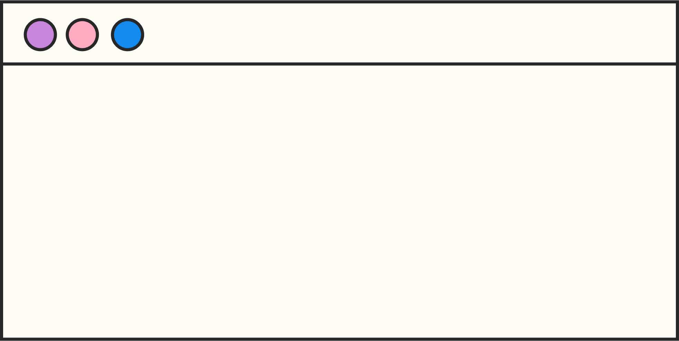





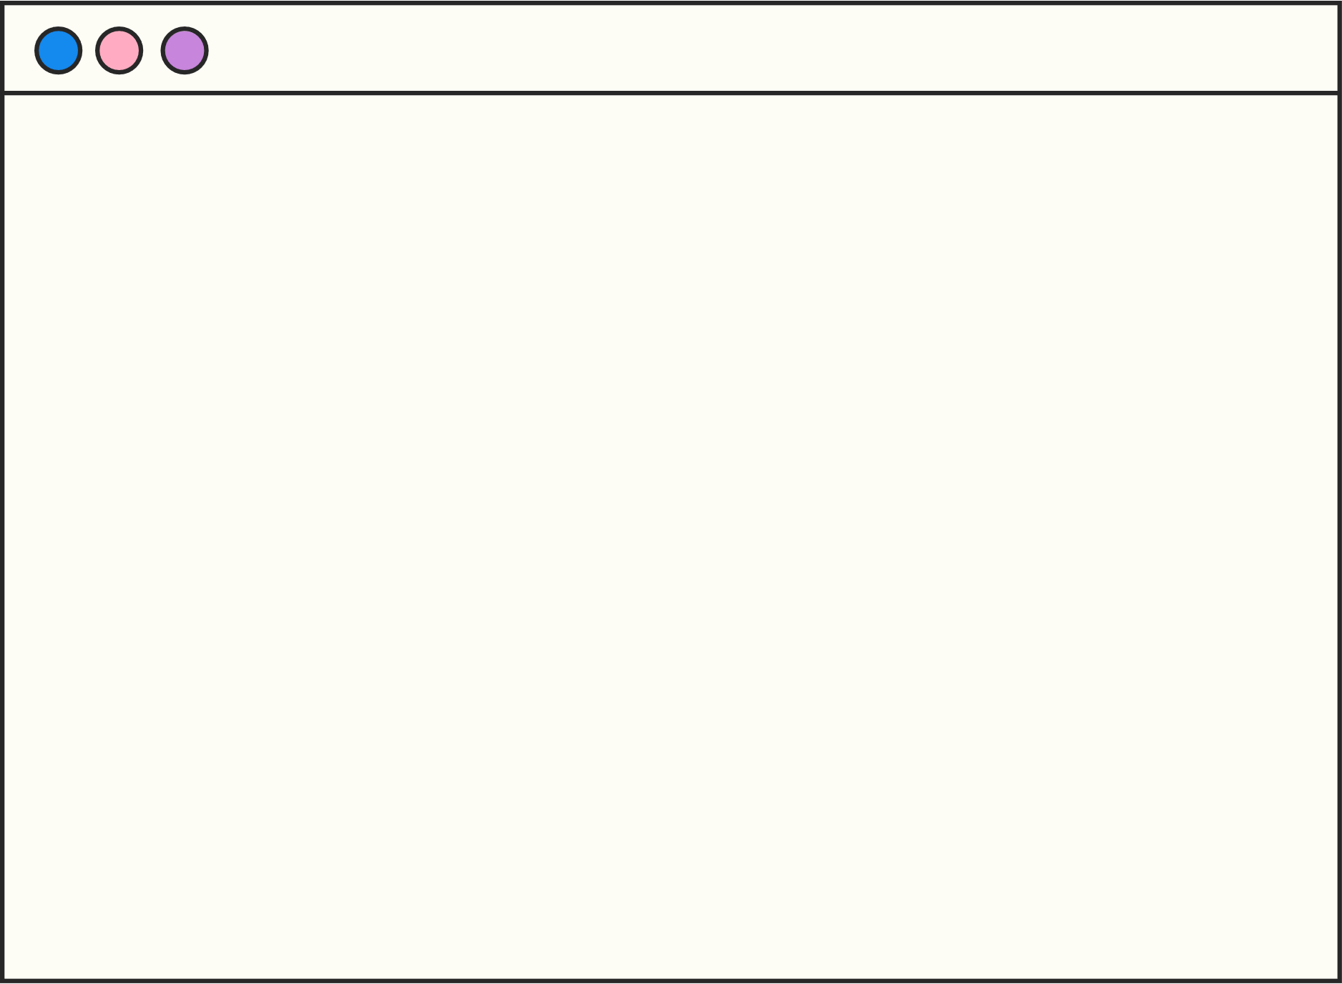
Attention: This webdev workshop is not for the faint-hearted. Brace yourselves for a transformation from novice to coding maestro. Prepare to challenge your limits.
GETTING STARTED WITH THE BASICS OF WEB DEV
AGENDAS
BUILDING A PERSONAL PORTFOLIO WEBSITE
BUILDING A PING PONG GAME
TONS OF LEARNING

Slide 3



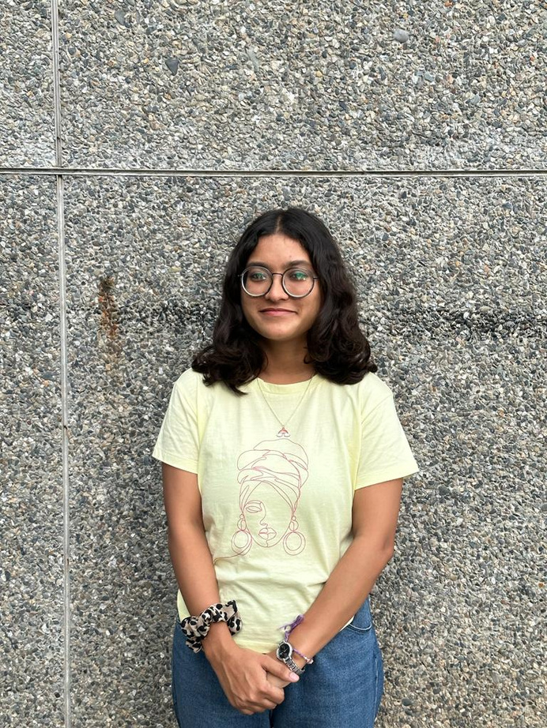
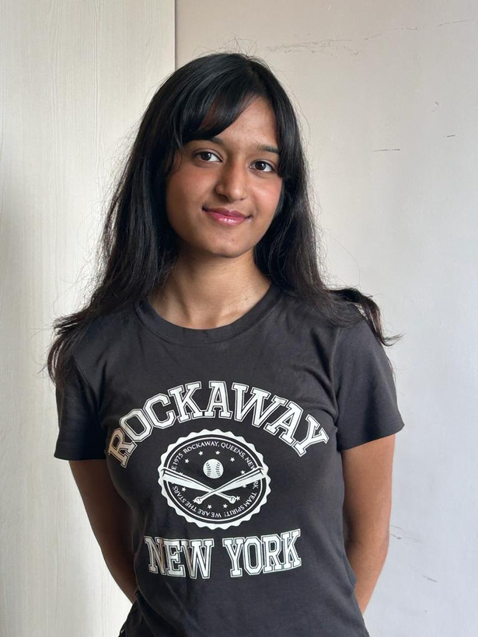
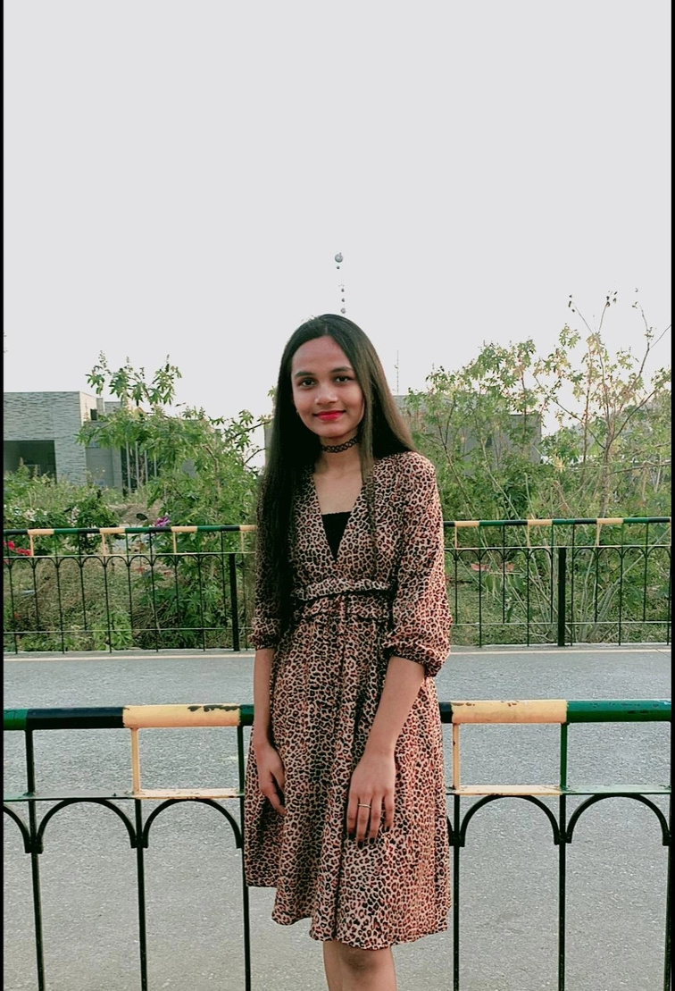
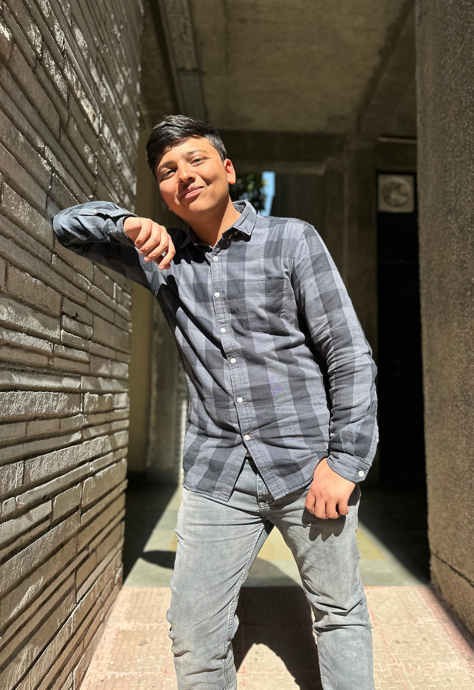



ARCHISHA DHYANI
BARKHA ARORA
ANSHIKA SRIVASTAVA
PUSHKAR JAIN
SPEAKERS FOR THE BOOTCAMP

